Slide 1


Title Slide
Project Title
Reducing Child Mortality: Data-Driven Strategies for Achieving SDG 3
by Mitchelle Musarurwa

Slide 2
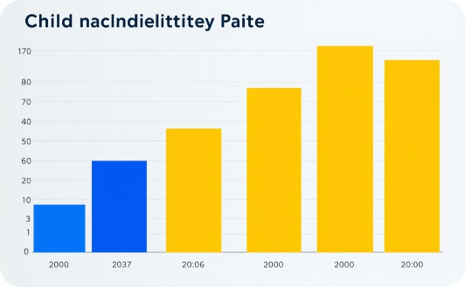
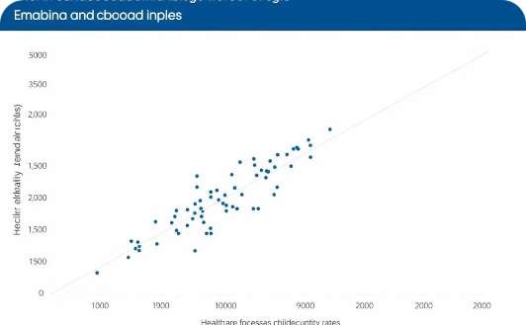
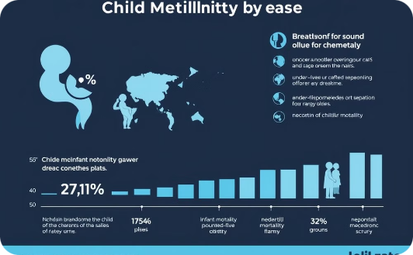
Problem Statement
Global Child Mortality
Preventable Deaths
Focus Areas
Globally, child mortality remains a significant issue, with high rates of infant, under-five, and neonatal deaths in many countries.
These deaths are preventable, and many regions are not on track to meet the SDG target of reducing child mortality.
Focus Areas: Infant mortality, under-five mortality, and neonatal mortality.

Slide 3

SDG 3: Good Health and Well-being
Goal
Ensure healthy lives and promote well-being for all at all ages.
Specific Target
By 2030, end preventable deaths of newborns and children under 5 years of age, with all countries aiming to reduce neonatal mortality to at least as low as 12 per 1,000 live births and under-5 mortality to at least as low as 25 per 1,000 live births.
Progress
Current progress is insufficient in many parts of the world.

Slide 4



Data-Driven Approach
Data Source
Purpose
Tools Used
Global datasets tracking infant, neonatal, and under-five mortality across various countries.
Analyze trends, identify high-risk regions, and measure the impact of healthcare interventions.
SQL, MySQL for data storage and analysis, and visualization tools for insights.

Slide 5
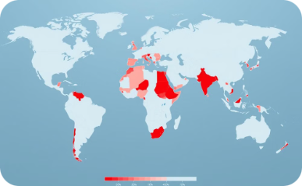
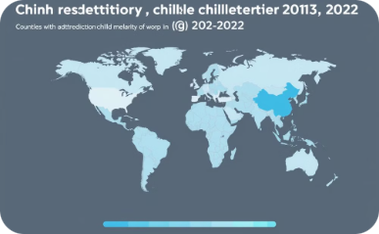
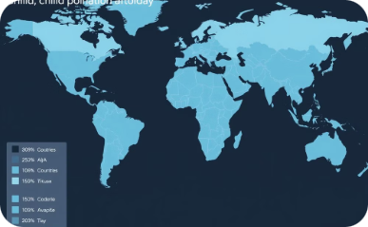
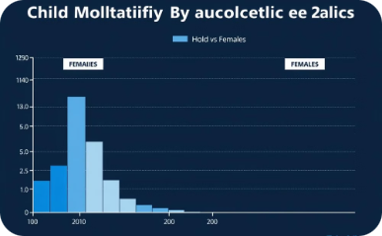
Key Insights from the Data
Highest Infant Mortality Rates
Significant Reductions
Lagging Progress
Gender Disparities
Countries where progress is lagging or where child mortality rates have increased.
Disparities in child mortality rates between males and females.
Countries with the highest infant mortality rates in 2022 (e.g., Afghanistan, Somalia).
Regions showing the largest reductions in mortality between 2013 and 2022.

Slide 6

Case Study: Infant Mortality in Nigeria
From 2013 to 2022, Nigeria showed consistent improvements in reducing infant mortality but remains one of the highest-risk regions. Countries with well-targeted healthcare interventions showed greater progress.

Slide 7



Neonatal Mortality: A Critical Focus Area
Tackling Neonatal Mortality
Global Average Neonatal Mortality
Interventions Needed
Neonatal mortality, the death of a baby within the first 28 days of life, remains a major global health concern. We need to understand where the highest rates occur to focus our resources and interventions.
Identifying the regions with the highest neonatal mortality rates is crucial to direct efforts towards improving birth conditions, neonatal care, and maternal health. By understanding these trends, we can work towards reducing these preventable deaths.
Focusing on improving birth conditions, neonatal care, and maternal health are essential components of reducing neonatal mortality. By implementing effective interventions, we can save lives and ensure a healthier future for newborns.

Slide 8
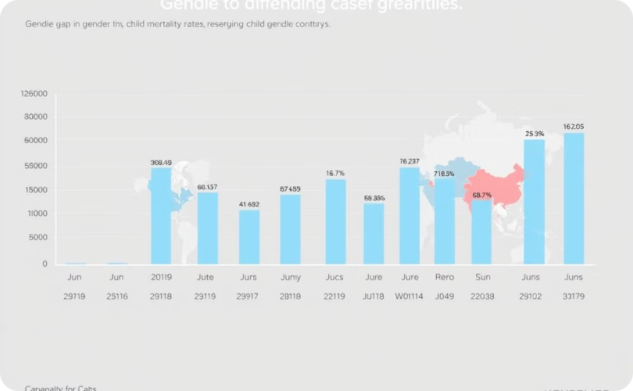

Impact of Gender on Child Mortality
Gender Disparity in Child Mortality
Addressing Gender Disparities
Significant differences exist between male and female child mortality rates in certain countries.
Targeted programs that focus on gender disparities can help ensure equal access to healthcare for all children.

Slide 9
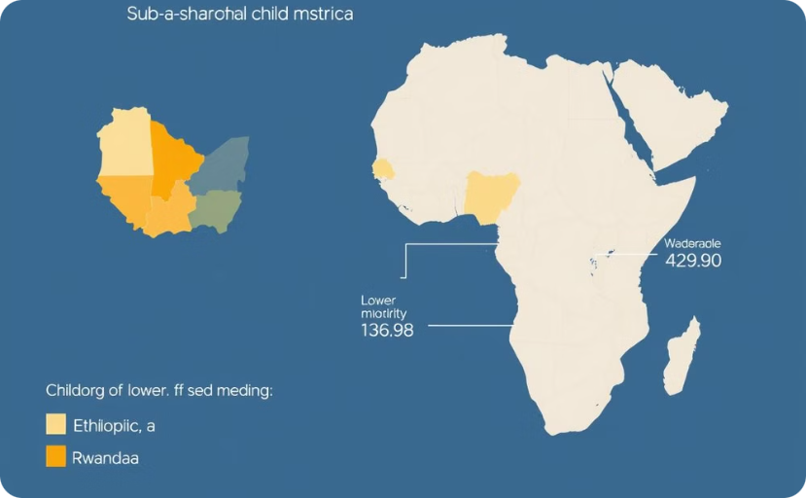

Regions with the Most Significant Progress
Successful Interventions in Sub-Saharan Africa
Insight
These countries implemented comprehensive healthcare strategies, including vaccination programs, maternal care, and access to clean water.
Highlight countries like Ethiopia and Rwanda, where child mortality has been significantly reduced.

